Slide 1

Climate Change and Fiscal Risks
November 12, 2024
Moulay El Omari (Afritac South)
Vimal Thakoor (ATI)
Joint ATI-CEF Webinar

Slide 2
Outline
Climate change and macro-fiscal risks
Building resilience to fiscal risks
Role of Public Financial Management (PFM):
  Climate Public Investment Management Assessment
  Green PFM

Slide 3
Climate Change: Channels and Impacts
Climate Change
Sectoral
Productivity
Vulnerabilities
Weakened human capital
Declining capital productivity
Desertification
Reduced agricultural yields
Hydro generation capacity
Tourism
Social vulnerabilities
Environmental degradation
Propagation of diseases
Long-term: Rising temperatures and sea levels
Recurrent manifestations: Storms, Floods, Droughts, …
Expected to increase in frequency and severity

Slide 4
Climate Change: Macro Implications
Growth; Inflation; Investment
Real
Revenue; Expenditure; Deficit; Debt
Fiscal
Exports; Imports; External financing
External
Interest rates; Domestic financing
Monetary

Slide 5



Climate change and debt sustainability
Climate change can impact fiscal sustainability through various channels
Public debt dynamics can be illustrated with this equation (Escolano, 2010):
  $r_{t}^{w}$: real interest rate (weighted average, domestic & foreign)
  $g_{t}$: real GDP growth between (t-1) and t
  $φ_{t}$: automatic (recursive) dynamics, $φ_{t}>$1 if $r_{t}^{w}$> $g_{t}$➔ explosive debt dynamics
This fundamental relationship can guide our analysis of how climate risks and adaptation can affect debt sustainability
$d_{t}=φ_{t}d_{t−1}−{pb}_{t}$ + ${cg}_{t}$
$$φ_{t}=\frac{1+r_{t}^{w}}{1+g_{t}}$$
Debt-to-GDP ratio
Contingent liabilities
(as % of GDP)
Primary balance
(as % of GDP)

Slide 6



Climate change and climate policies can impact fiscal sustainability through various channels
Climate change and fiscal sustainability
Output ($g_{t}$)
Fiscal balance (${pb}_{t}$):
Borrowing cost ($r_{t}^{w}$)
  Damages to physical assets
  Productivity
  Uncertainty
  Incentives for private investment
  Augmented public investment in resilience building (+)
  Revenues
    Impact on GDP
    Carbon tax
  Expenditures
    Adaptation investment
    Reconstruction, relief spending
    Social transfers
    Energy subsidy reform
  Climate vulnerability
  Preparedness and resilience to climate risks
  Institutional capacity to implement adaptation policies
Notes:
Climate change impact GDP through multiple channels—as we discussed earlier.
By destroying physical assets and harming human lives.
Through adverse effects on productivity.
Augmented public investment in resilience-building
Climate policies can also affect investment, revenues, and expenditures. Example, investing in adaptation (including more resilient infrastructure) provides protection to both public and private assets and mitigates productivity losses, raising returns to private investment and spurring output growth.
Climate shocks also worsen fiscal balance ex post in several ways.
Lower revenues due to asset destruction and drop in GDP.
Higher spending, including to provide lifeline and reconstruction support.
Below the line, financing needs are likely to trigger additional borrowing and lead to higher borrowing costs.
On the opposite, investing in adaptation reduces post-disaster fiscal costs for rebuilding and lifeline support, resulting in better fiscal outlook, and less debt accumulation in the long run.
Climate change can lead to higher borrowing costs because:
It causes damages to government balance sheet and results in repricing sovereign wealth, with adverse impact on credit quality and debt refinancing rates (e.g., carbon-intensive assets in public ownership, such as coal mines or energy utilities)

Slide 7
Climate change and discrete fiscal risks
Arise from direct exposure of government, SOEs, PPPs:
      Direct physical risks to the assets;
      Transition risks affect the viability of assets and contracts.
Assessing the impact of natural disasters and magnitude of risks is complex:
      Costs are not recorded systematically (reallocating spending, transferring unspent funds, expenditure at various levels), but partial estimates can be developed
      Fiscal risks can be explicit or implicit, making their impact upon materialization uncertain

Slide 8
Transmission channels
Fiscal risks: Transmission channels
Risk Factor | Climate Change and Natural Disasters Channels
Macro and fiscal risks | Increased severity and likelihood of extreme events Disruption to agriculture, fishing, mining, tourism, infrastructure
Commodity Prices | Increased volatility in world commodity prices
SOEs and PPPs | Impact on operations, infrastructure, and financial viability,
Public health emergency | Spread of vector-borne diseases, deaths from heat events, cascading events, etc.
Judicial awards | Governments made liable for compensation and climate adaptation measures
Insurance schemes | Insurance schemes backed by state guarantees
Notes:
Others – interest and exchange rates, pension obligations, wage settlements, policy changes expected to have negligible impact from climate change

Slide 9
Outline
Climate change and macro-fiscal risks
Building resilience to fiscal risks
Role of Public Financial Management (PFM):
  Climate Public Investment Management Assessment
  Green PFM

Slide 10
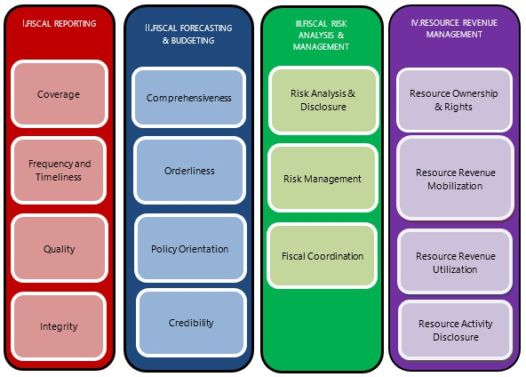
Building fiscal resilience to climate-related risks
Fiscal risk management framework
Pillar III: Fiscal risk analysis and management
Risk analysis & Disclosure
Macroeconomic Risks
Specific Fiscal Risks
Risk Management
Budgetary Contingencies
Asset and Liability Management
Fiscal Coordination
Sub-National Governments
Public Corporations
Long-Term Sustainability
Guarantees
Natural Resources
PPPs
Financial Sector
Environmental risks
IMF Fiscal Transparency Code
Source: IMF Fiscal Transparency Code

Slide 11
Building fiscal resilience to climate-related risks
Fiscal risk management cycle
Identify and quantify risk
Identify sources of risk
Calculate fiscal exposure
Decide whether to mitigate risks
Direct controls and limits on exposures
Regulation, incentives, and other indirect measures
Decide whether to provision for risks
Expense fiscal costs in the budget
Budget contingencies
Decide whether to accommodate residual risks
Estimate likelihood of realization
Transfer and risk sharing mechanisms
Set aside financial assets in buffer funds
Take into account in setting debt objectives
Performance on Pillar III (Fiscal Risks)
by Income Group

Slide 12
Building fiscal resilience to climate-related risks
Managing fiscal costs of natural disasters
Determining the size of Fiscal Buffers
Quantify vulnerabilities
Invest in risk reduction
Building Fiscal Buffers Through Budgets
Medium-Term Fiscal Framework
Contingency Reserves in the Budget
Using Fiscal Buffers Transparently
Post disaster budget execution
Flexibility in Fiscal Rules
Adopt flexibility while preserving credibility
Develop contingency financing plans
Build fiscal buffers
Natural Disaster Fund
Virement
Budget reallocation modalities
Supplementary budget
Re-prioritization of expenditure among budgets

Slide 13
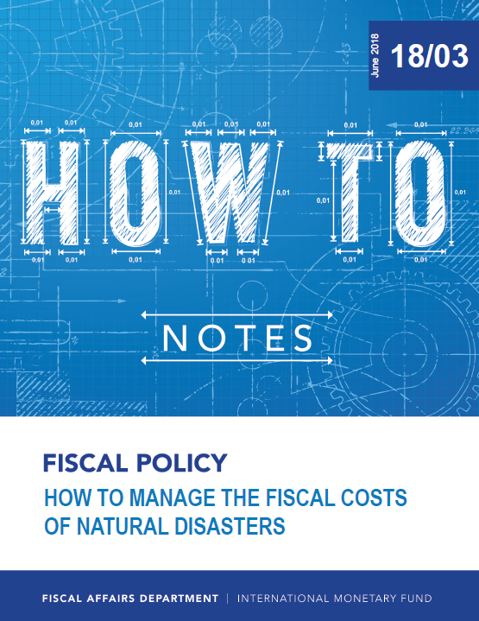
Further information
  IMF - HOW TO NOTE: How To Manage The Fiscal Costs Of Natural Disasters 2018

Slide 14
Outline
Climate change and macro-fiscal risks
Building resilience to fiscal risks
Role of Public Financial Management (PFM):
  Climate Public Investment Management Assessment
  Green PFM

Slide 15
Linking Climate Change and Public Investment Management
    Climate change requires investment to build resilience
      Investment needed depends on countries’ income level (more investment needed in low-income and small states), but also on the ambition in terms of the climate objectives (both adaptation and mitigation)
      With many developing countries facing reduced fiscal space and elevated debt levels, there is an added onus on ensuring the investment being undertaken is climate-sensitive, but also investment processes are efficient
    Investing in climate resilience will ensure cost of climate change is reduced and physical infrastructure is better able to withstand climate-related shocks—a win-win
    Need to integrate the public investment needs in budget processes

Slide 16
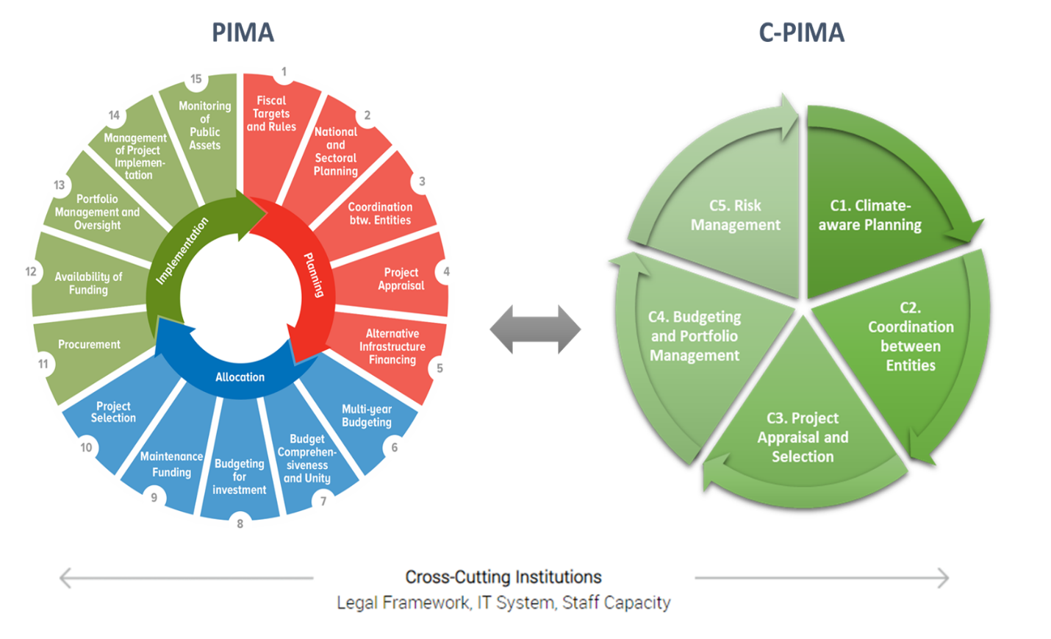
The Climate-Public Investment Management Assessment (C-PIMA).
The C-PIMA framework
The “Climate-PIMA” (C-PIMA) adds a climate-responsive dimension into the PIMA framework and assesses countries’ capacity to manage climate-related infrastructure.
The C-PIMA involves an assessment of the five institutions of public investment management that are key for climate-proof infrastructure:
      C1. Climate-aware planning.
      C2. Coordination between entities.
      C3. Project appraisal and selection.
      C4. Budgeting and portfolio management.
      C5. Risk management.
      The C-PIMA also assesses the three cross-cutting issues equally important to managing climate-relevant public investment management institutions:
        The legal and regulatory framework,
        Information systems
        Government staff capacity.
https://infrastructuregovern.imf.org/content/PIMA/Home/PimaTool/C-PIMA.html

Slide 17

The Climate-Public Investment Management Assessment (C-PIMA).
The C-PIMA framework : Five institutions, 15 dimensions
C1. Planning
1a: National and sectoral public investment strategies and plans
C2. Coordination between entities
2a: Coordination at central government level
2b: Coordination with subnational authorities
C3. Evaluation
ex ante and
Project selection
3rd: Ex-ante evaluation of major projects that integrate climate considerations
C4. Budgeting and project portfolio management
C5. Risk management
4a: Identification of climate-related public investments
5a: Disaster Risk Management Strategy
2c: Coordination with public enterprises
1b: Spatial planning and building codes
1c: Central government support for climate-sensitive public investment planning
3b: PPP framework and climate risk sharing
3c: Project selection based on climate considerations
4b: Ex-post evaluation of public investments in climate change adaptation and mitigation
4c: Management and maintenance of climate-sensitive assets
5b: Ex-ante financing to manage climate risks
5c: Fiscal risks, including climate-related risks

Slide 18
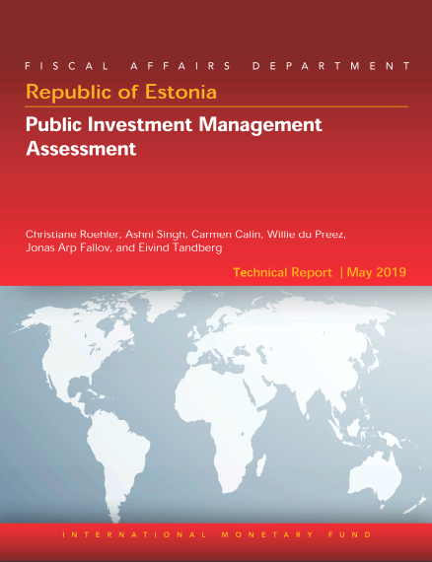
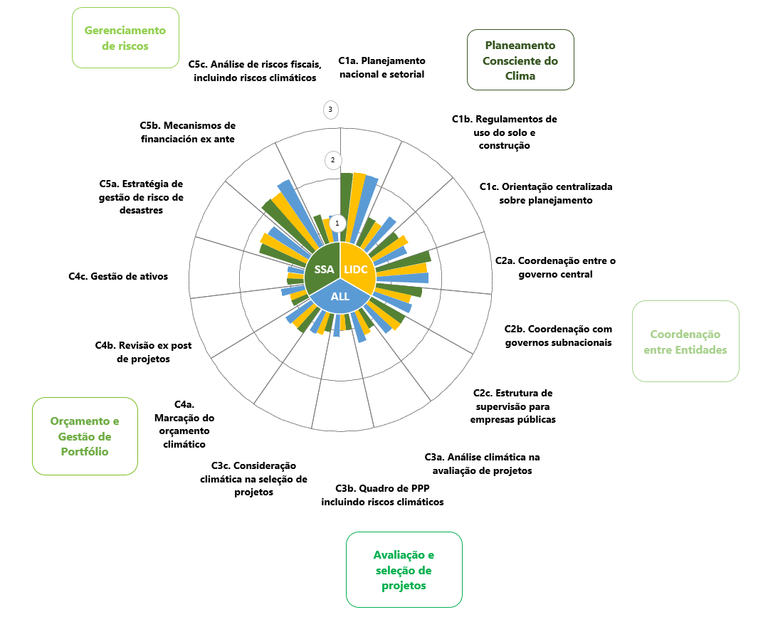
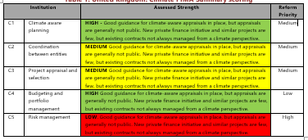
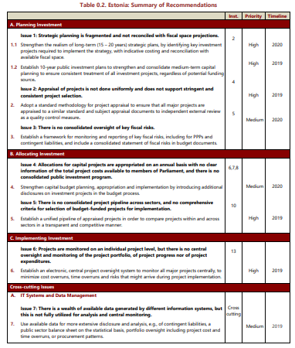
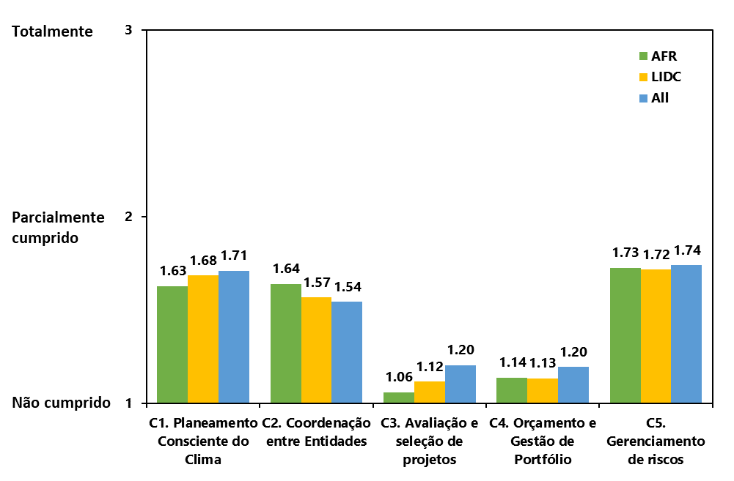
The Climate-Public Investment Management Assessment (C-PIMA).
The benefits of C-PIMA and key outputs
Benefits
Key outputs
Diagnostic. Assess institutional readiness and gaps in PIM against the backdrop of climate change challenges.
Institutions. Support the development of institutions for addressing climate-related risks in infrastructure planning and investment.
Roadmap. Identify reform actions and explore capacity development support from the IMF and other organizations.
Access global climate financing. Increase opportunity to access grant financing.
Peer exchange. Learn from—and share experiences with—other countries that face similar issues and challenges.
Detailed assessment report | Comparator charts | Heatmap of findings | Sequenced Recommendations and Action Plan
  C-PIMA is Complementary to other existing tools:
  PEFA Climate Change
  Climate Macroeconomic Assessment Program(CMAP)
  Green PFM and green budgeting
  ….

Slide 19
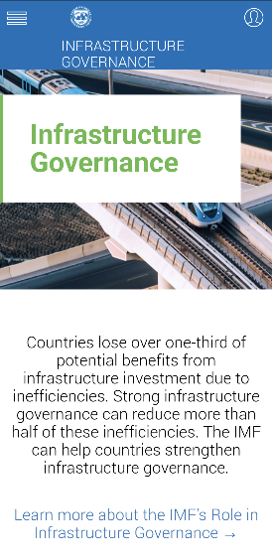
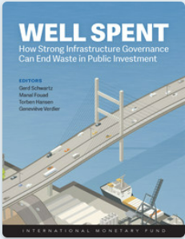
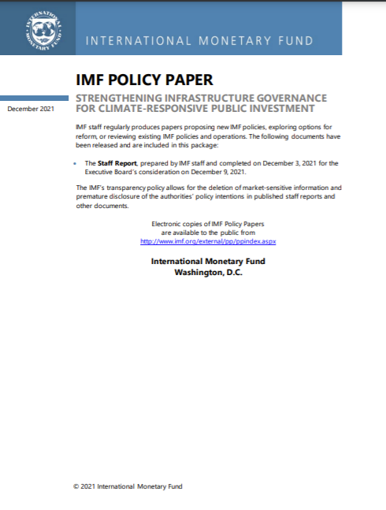
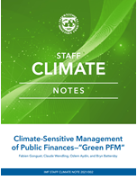
Further information
  IMF Public Investment Management website www.infrastructuregovern.imf.org
  Well Spent How Strong Infrastructure Governance Can End Waste in Public Investment (2020)
  Strengthening Infrastructure Governance for Climate-responsive Public Investment
  (2021)
  Staff Climate Note Climate-Sensitive Management of Public Finances—"Green PFM” (2021)

Slide 20
Outline
Climate change and macro-fiscal risks
Building resilience to fiscal risks
Role of Public Financial Management (PFM):
  Climate Public Investment Management Assessment
  Green PFM

Slide 21




What is Green Public Financial Management (Green PFM)?
Green PFM is the integration of a climate-friendly perspective into PFM practices, systems and frameworks – especially the budget process– with the objective to promote fiscal policies that respond to climate concerns.
Green PFM is NOT a novel approach to PFM but rather an adaptation of the existing PFM processes and tools.
Green PFM does NOT encompass the design of fiscal instruments to achieve green objectives such as carbon taxation or green subsidies
Practices
Systems
Green PFM
Frameworks
IMF,2022- How-to-Note “How to Make the Management of Public Finances Climate Sensitive”

Slide 22

Green fiscal policies
Adopt and lead policies to curb climate change
Green PFM
Ensure that said policies are optimally designed and implemented
Why Does Green PFM Matter?
Achieving
How to ensure the coherence of the budget with green commitments ?
What guidance to give line ministries on climate goals when they prepare their budget ?
How to prepare an MTFF that considers revenue and spending implications of climate policies?
What are the specific transparency requirements on climate-related matters?

Slide 23



Why Does Green PFM Matter?
60 percent of OECD countries do not implement any form of green budgeting
(source: OECD, 2021).
Green PFM practices are nascent or non-existent in most countries, including in advanced economies.
Growing demand from ministries of finance to orient PFM systems to achieving macro-critical green outcomes.
Only 25% of countries publish quantitative information about environmental risks
(source: FTEs delivered in 31 countries as of early 2021).
19 governments have implemented climate or green budget tagging since 2012, including four in Africa (Ethiopia, Ghana, Kenya and Uganda)
(source: WB, 2021)

Slide 24





Green PFM at the heart of the International Cooperation Agenda
Policy Note on Moving Toward Climate Budgeting
First tentative blueprint for the integration of green budgeting principles in the PFM cycle
Helsinki Principle 4 – MAINSTREAM
Take climate change into account in macroeconomic policy, fiscal planning, budgeting, public investment management, and procurement practices
2014
2017
2019
What about the IMF?
Diagnostic - CMAP
Capacity Development (Workshops, Training, online courses…)
Green PFM Framework
Climate-PIMA
Capacity Development
Decade-long experience in supporting some low-income or emerging countries in the implementation of climate budgeting
Paris Collaborative on Green Budgeting
Building blocks for green budgeting, inventory of successful country experiences (AEs), introductory guidance on green budget tagging

Slide 25
Green PFM
A Holistic Framework
An identification of
        entry points of the climate change dimension within the budget cycle.
        interactions with PFM functions across and beyond the budget cycle, i.e., that touch upon every stage of the budget cycle (e.g., Fiscal transparency) and/or are only partly addressed in the budget cycle (e.g., Coordination with SOEs and SNGs).
An adaptation of existing PFM processes and tools, not a novel approach to PFM

Slide 26


Green PFM framework
Strategic Planning and Fiscal Framework
Climate objectives / targets
Climate-responsive macro-fiscal framework
LT sustainability analysis
PIM Cycle
Strategic
Planning
And Fiscal Framework
Budget
Cycle
Examples:
South Africa’s National Development Plan
Kenya’s National Climate Change Action Plan
Mozambique’s Climate-Change Strategy
Example:
Nigeria’s five-year carbon budget
LEGAL
FRAMEWORK

Slide 27


Green PFM framework
Budget preparation
Climate objectives / targets
Climate-responsive macro-fiscal framework
LT sustainability analysis
PIM Cycle
Strategic
Planning
And Fiscal Framework
Climate impact assessments / CBA
Green / climate spending reviews
Climate budget circular
Green-responsive program budget
Budget
Cycle
LEGAL
FRAMEWORK
Examples: Burkina Faso’s budget call circular, Rwanda’s budget guidelines
Budget Preparation
Example: Uganda

Slide 28

Green PFM framework
Budget Execution and Accounting
Climate objectives / targets
Climate-responsive macro-fiscal framework
LT sustainability analysis
PIM Cycle
Strategic
Planning
And Fiscal Framework
Climate impact assessments / CBA
Green / climate spending reviews
Climate budget circular
Green-responsive program budget
Budget
Cycle
LEGAL
FRAMEWORK
Tagging climate expenditure
Green trackers
Green performance monitoring
Budget Execution And Accounting
Budget Preparation

Slide 29


Green PFM framework
Control and Audit
Climate objectives / targets
Climate-responsive macro-fiscal framework
LT sustainability analysis
PIM Cycle
Strategic
Planning
And Fiscal Framework
Climate impact assessments / CBA
Green / climate spending reviews
Climate budget circular
Green-responsive program budget
Control And Audit
Budget
Cycle
LEGAL
FRAMEWORK
Tagging climate expenditure
Green trackers
Green performance monitoring
Budget Execution And Accounting
Example: Ethiopia’s performance audits
Budget Preparation
Ex-post climate / green audits
Climate watchdogs
Parliamentary oversight
Example: Ethiopia’s Parliamentary Standing Committee on Climate Change, Uganda’s Natural Resources Committee

Slide 30



Green PFM framework
Legal Framework
Climate objectives / targets
Climate-responsive macro-fiscal framework
LT sustainability analysis
PIM Cycle
Strategic
Planning
And Fiscal Framework
Climate impact assessments / CBA
Green / climate spending reviews
Climate budget circular
Green-responsive program budget
Control And Audit
Budget
Cycle
LEGAL
FRAMEWORK
Tagging climate expenditure
Green trackers
Green performance monitoring
Budget Execution And Accounting
Budget Preparation
Ex-post climate / green audits
Climate watchdogs
Parliamentary oversight
Amending existing PFM laws to include climate elements
Enacting specific climate action laws

Slide 31
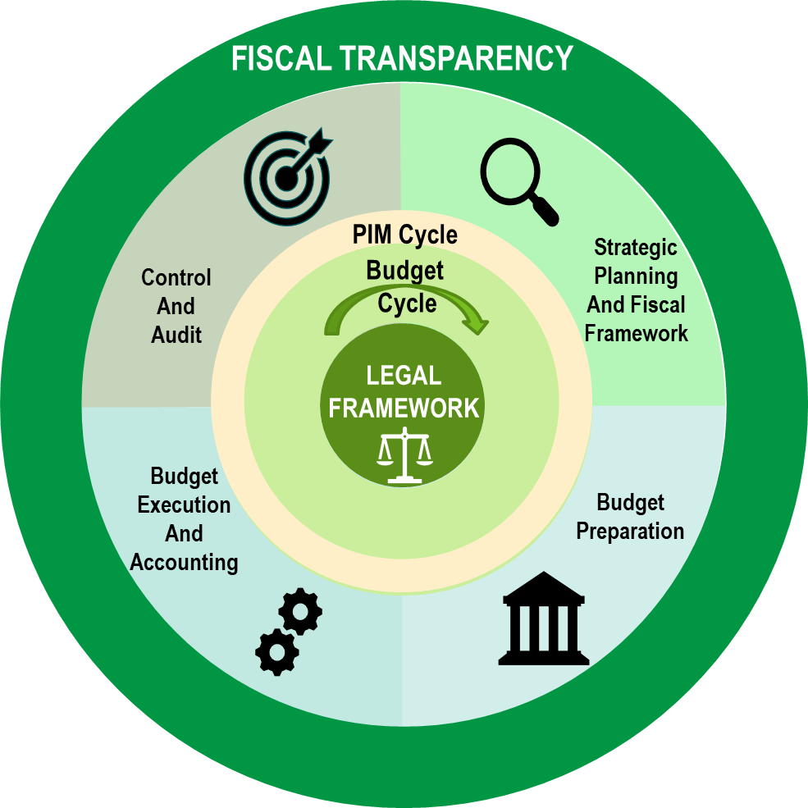
Green PFM framework
Interaction with other PFM functions : fiscal transparency
Climate objectives / targets
Climate-responsive macro-fiscal framework
LT sustainability analysis
Climate impact assessments / CBA
Green / climate spending reviews
Climate budget circular
Green-responsive program budget
Tagging climate expenditure
Green trackers
Green performance monitoring
Ex-post climate / green audits
Climate watchdogs
Parliamentary oversight
Amending existing PFM laws to include climate elements
Enacting specific climate action laws

Slide 32
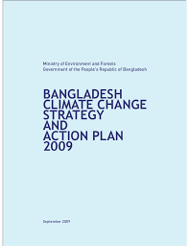
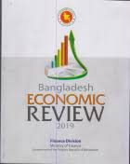
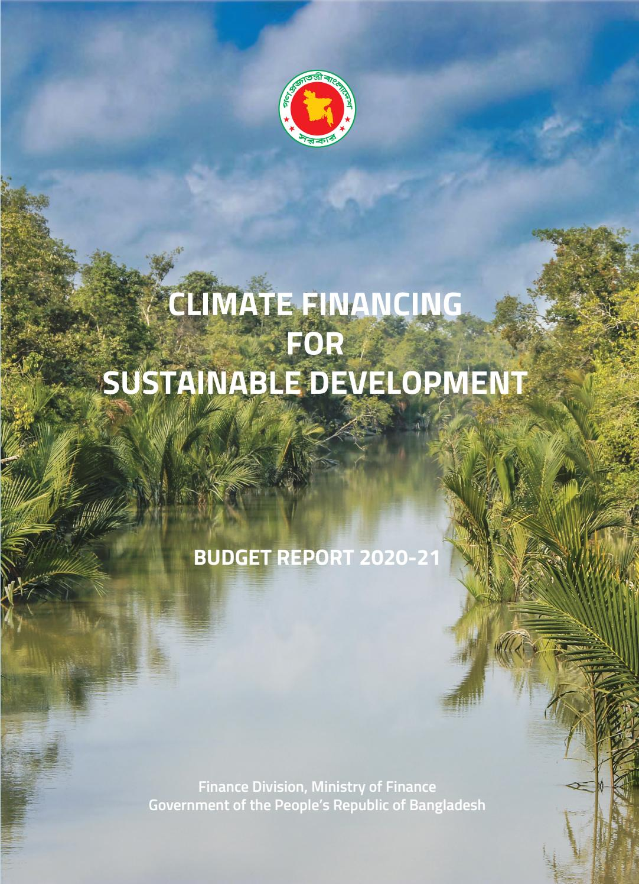
An Example Green PFM practices: Bangladesh
Climate Change Strategy
Climate Performance Audits
Medium-Term Macroeconomic Framework
Climate-inclusive Budget Circular
Green Elements in Economic Review
Climate Budget Report
Integration in budget classification and FMIS
Climate Budget Tagging

Slide 33
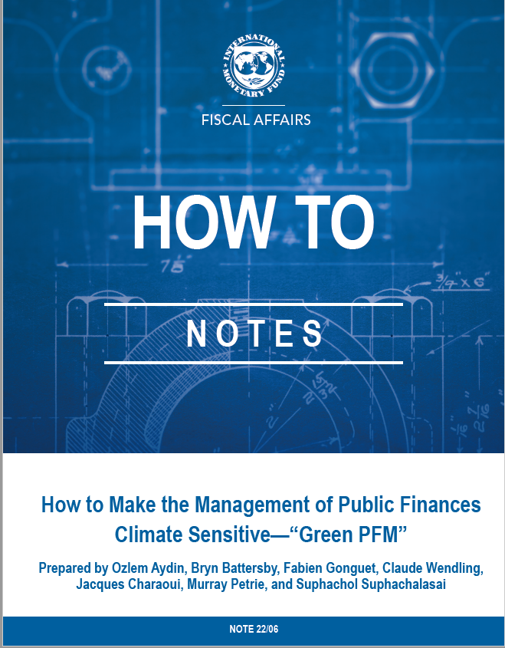
Further information
  Staff Climate Note Climate-Sensitive Management of Public Finances—"Green PFM” (2021)
  Staff Climate Note How to make the management of public finances climate sensitive—"Green PFM” (2022)

Slide 34
Further reading
IMF Climate Strategy (2021)
Carbon Taxes or Emissions Trading Systems? Instrument Choice and Design (2022)
Economic Principles for Integrating Adaptation to Climate Change into Fiscal Policy (2022)
Macro-Fiscal Implications of Adaptation to Climate Change (2022)
Planning and Mainstreaming Adaptation to Climate Change in Fiscal Policy (2022)
Climate-Sensitive Management of Public Finances—"Green PFM” (2021)

Slide 35

Thank you

Slide 36
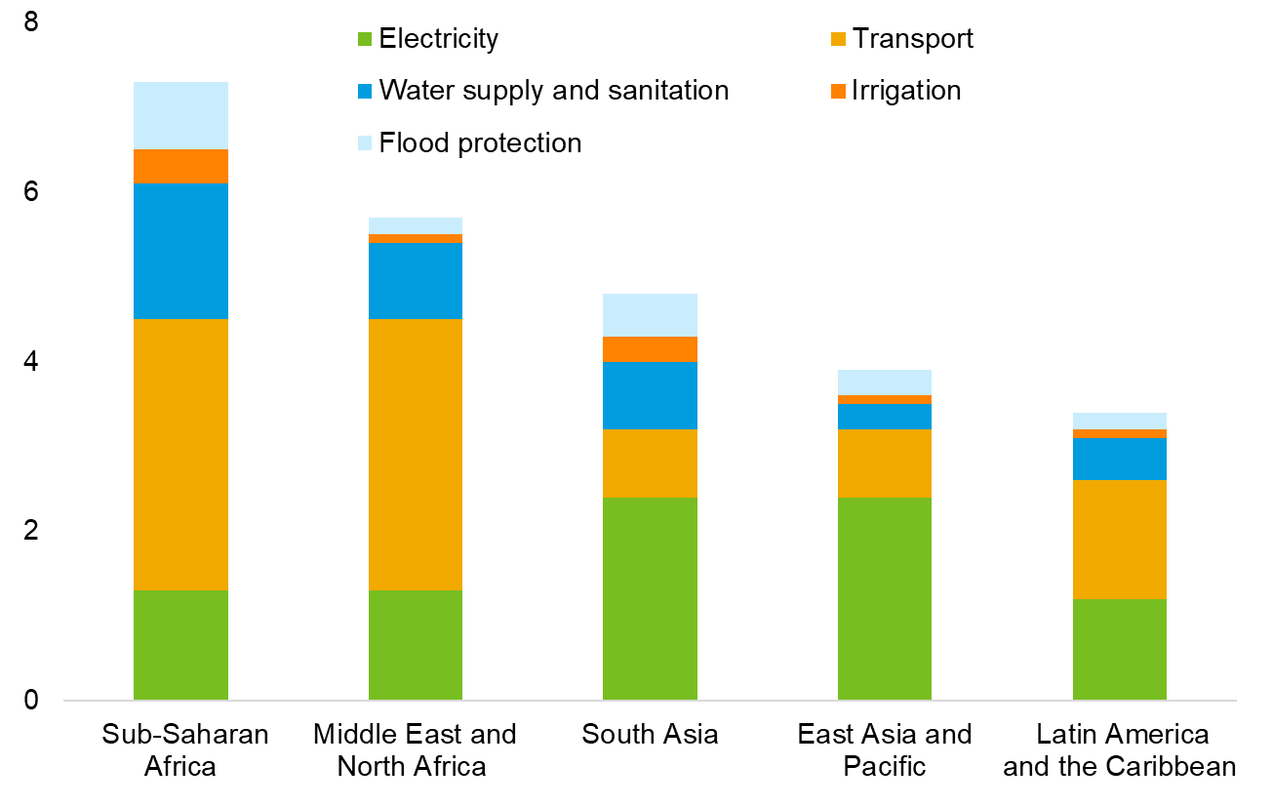
The impact of climate change on public investment management
Infrastructure investment needs
Capital Investment requirement by 2030
(average annual, as percentage of regional GDP)
  To achieve SDGs and get on track for the Paris Agreement goals, the average annual capital cost for LMIC would be 4.5 % of annual GDP up to 2030, and 2% of annual GDP globally.
  The average annual capital cost for SSA would be 7.2% of regional GDP up to 2030.
  Infrastructure investment needs are higher in SSA, compared to other regions.
  Source: World Bank, 2019.

Slide 37
Incorporating climate change into Public Investment Management systems
The benefits …
  Increase of over 30 million jobs within the next decade
Incorporating Climate change in PIMS
  Every US$1 invested in resilient infrastructure yields US$4 in net benefits in LMIC.
Public investment efficiency
  Source: World Bank, 2019.

