Slide 1
Institutions for Growth and Development in the Arab World
Dr. Mohamed Maait
Executive Director Representing Arab States and the Maldives
Former Minister of Finance of The Arab Republic of Egypt
November 11, 2025
Kuwait Investment Authority, Kuwait City - Kuwait

Slide 2
Table of Contents
Introduction: Regional Growth Highlights
The Current Environment of Economic Uncertainty
The Importance of Maintaining High Growth Amid the Uncertain Environment
Growth Boosting Structural Reforms (3Ds) are Crucial for Debt Sustainability and Macroeconomic Stability
Building resilience through Structural Reforms
Designing Institutions for Growth
Automation, digitalization and AI Preparedness
Private Sector Development
Trade Diversification
Labor Market Reform and Development
The role of The International Community in financing growth and transformation
Lessons from Past Experiences—Globally and Regionally
Policy Recommendations for Countries in the Region

Slide 3
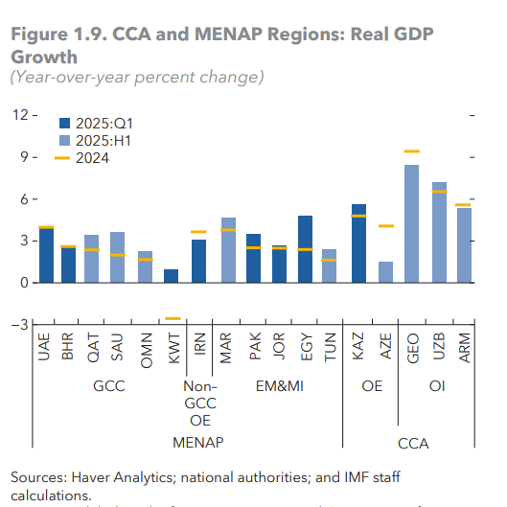
1. Introduction - Regional Growth Highlights
2- The Arab Region’s Development Challenge
In 2025, MENAP economies have demonstrated strong resilience amid ongoing global volatility and regional challenges. The region's GDP growth is now forecasted to be 3.2%, an increase from 2.1% in 2024 and a 0.6% upward revision since May.
Strong domestic demand, increased oil production, and accommodative financial conditions helped sustain economic activity across most MENA countries in the first half of 2025.
In the GCC, growth remained solid, supported by robust domestic demand, driven in part by ongoing diversification efforts and the rebound in hydrocarbon production.
Among MENA oil importers, growth in 2025 benefited from strong tourism inflows (Egypt, Morocco, Tunisia), a rebound in agricultural production (Jordan, Morocco, Tunisia), rising infrastructure investment (Morocco), and resilient remittances (Egypt and Jordan).
- Despite natural resource wealth and a young population, many Arab countries face:
- High youth unemployment
- Low productivity
- Weak private sector development
Source –REO October 2025

Slide 4
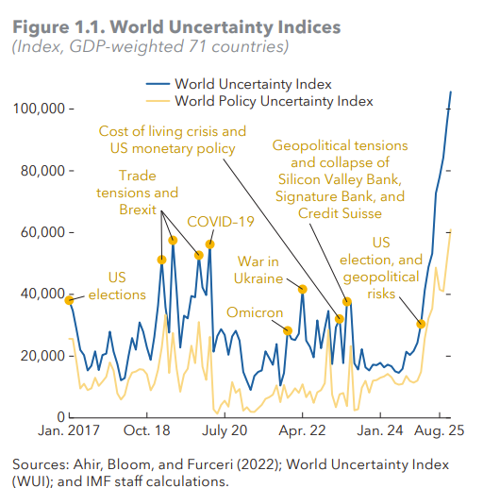
2. The Current Environment of Economic Uncertainty
2- The Arab Region’s Development Challenge
Elevated uncertainty and significant policy shifts are reshaping global economic and fiscal outlooks.
Tighter and more volatile financial conditions may have ripple effects on EMDEs, leading to higher financing costs and needs.
Significant Reduction in Official Development Assistance (ODA) is adding additional burden on many countries in the Arab region, especially fragile and conflict affected states (FCS).
It is expected that these measures will place additional pressure on public resources, debt-to-GDP ratios as well as other major indicators and eventually growth (GDP),
- Despite natural resource wealth and a young population, many Arab countries face:
- High youth unemployment
- Low productivity
- Weak private sector development
Source –REO October 2025

Slide 5
3. The Importance of Maintaining High Growth Amid
the Current Uncertain Environment
1- Introduction: Why Institutions Matter for Macroeconomic Stabilization and Development
Despite the regions’s strong resilience, the ongoing global volatility and persistent regional challenge, many countries grappling with stretched budgets and rising public debt burdens.
In this environment, countries need to be agile with their growth frameworks and implement growth friendly policies whilst pushing for structural reforms that increase productivity.
Furthermore, countries have to work on strengthening institutions as it correlates with higher GDP per capita and inclusive growth. Institutions shape incentives, reduce uncertainty, and foster trust in economic transactions.
In order to strengthening institutions, there is a need to work on the followings:
Designing Institutions for Growth (legal, structural, infrastructural, human resources --ext.),
Automation, digitalization and AI Preparedness become a must,
Private Sector led Development and Growth,
Labor Market Development and Reform to Enhance Productivity.

Slide 6



Driving Economic Resilience: Growth Strategies
4. Growth Boosting Structural Reforms (3Ds) are Crucial
for Debt Sustainability and Macroeconomic Stability
Boosting growth through productivity enhancing structural reforms facilitates nominal GDP to move at a faster pace compared to debt levels, improving overall debt sustainability.
Direct policies towards implementing the 3Ds to foster resilience and growth:
Diversification: diversify more sectors of the economy.
De-regulation: strengthen governance and boosts private sector role in the economy and attract more FDI.
Digitization: increase the role of automation, digitalization and AI to increase productivity and efficiency.

Slide 7
5.1 Building Resilience Through Structural Reforms
(Designing Institutions for Growth)
2- The Arab Region’s Development Challenge
- Despite natural resource wealth and a young population, many Arab countries face:
- High youth unemployment
- Low productivity
- Weak private sector development
Institutional quality is a key determinant of growth and inclusion.
For sustainable development, institutions must adapt digital government, transparent and capacity building. Specifically, institutions can be a driver for sustainable growth through their design. Countries in the region should prioritize building:
1. Adaptive institutions: as demographic changes ensue and climate challenges arise in the region, countries must design their institutions to be ready to deal with these challenges through digital governance and an agile regulatory environment.
2. Inclusive institutions: ensuring participation of youth and women with equitable access to services and opportunities.
3. Accountable and transparent institutions: the importance of the rule of law, audits, oversight mechanisms to reduce corruption.
Source –UNDP 2024 – Digital Inclusion in a dynamic World.

Slide 8




5.2 Building resilience through Structural Reforms
Building resilience against future shocks and seizing opportunities in the evolving global trade landscape would require an acceleration of structural reforms.
Recent reforms have played a significant role in sustaining growth across the MENA region.
Reforms have included diversification agendas in many countries such as Jordan, Morocco, and Saudi Arabia.
These initiatives have strengthened resilience and supported durable, private-sector-led growth. Nonetheless, further progress is needed in several longstanding and emerging areas, including through:
Private Sector Development
Trade Diversification
AI Preparedness
Labor Market Reforms
Source –REO/WEO October 2025

Slide 9
5.3 Building resilience through Structural Reforms
(Private Sector Led Development and Growth, Trade Diversification)
A. Private Sector Development:
In many countries in the region, private sector development remains hindered by persistent market barriers that limit market entry for new firms and constrain the growth of small businesses and startups.
Addressing these challenges will require continued reforms to reduce the role of state-owned enterprises, streamline government regulations, enhance financial inclusion, and improve general governance.
B. Trade Diversification:
Tackling structural barriers (non-tariff trade barriers) to deeper integration can allow the MENA to diversify export markets, improve regional connectivity and integration, and capitalize on opportunities arising from the ongoing restructuring of global supply chains.
Source –REO/WEO October 2025

Slide 10
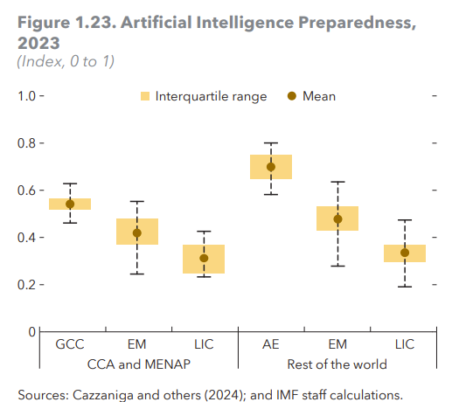
5.4 Building resilience through Structural Reforms
(Automation, Digitalization and AI Preparedness)
2- Regional Success Stories
D. AI Preparedness:
The full automation and digitalization and arrival of generative AI presents an opportunity for countries in the region to boost productivity and accelerate economic transformation.
IMF research shows that emerging markets and LICs in these regions lag somewhat behind GCC economies and their peers in other regions in terms of AI preparedness. This gap mainly reflects shortcomings in digital infrastructure, regulation, and innovation
Rapid progress in these areas would be needed to prevent a further widening of the income gap with more advanced economies.
Source –REO October 2025

Slide 11
5.5 Building Resilience Through Structural Reforms
(Labor Market Reform and Development)
C. Labor Sector Reforms:
Youth in the region face high unemployment rates compared to peer regions.
To minimize the risk that AI adoption exacerbates this issue, governments should invest in human capital, implement more effective active labor market policies, update labor codes that encourage flexible job formats, and provide targeted support for young job seekers.
The IMF has implemented various policies to enhance employment across different countries. These policies are designed to address various labor market challenges and promote sustainable employment growth. Here are some examples:
Active Labor Market Policies: These include job creation subsidies, training programs, and employment services aimed at improving job matching and increasing employment rates.
Tax and Expenditure Policies: The IMF advises on tax incentives and public spending measures to boost labor demand and supply.
Encouraging Female Labor Force Participation: Policies to support women’s participation in the labor market, such as childcare support, parental leave, and flexible working arrangements
Source –REO October 2025

Slide 12
6. The role of The International Community in financing growth and transformation
The IMF and other multilateral organizations are a driving force behind supporting growth models in Emerging Markets and specifically in our region, through financing structural reforms, providing technical assistance, and offering policy advice that strengthens macroeconomic stability, enhances institutional capacity, and fosters inclusive and sustainable development.
1. Low cost/concessional financing: MDBs and IFIs are able to lend to countries at rates that are lower than private finance. They can also scale up long-term concessional finance to developing countries at rates closer to those paid by developed countries.
○ The IMF announced the reduction of their general charges and surcharges by 36%.
○ Some MDBs have commitment fees and surcharges on their concessional products, which need to be revised.
2. Innovative Financial Instruments: MDBs and IFIs can support developing countries in using Innovative Financial Instruments such as Debt for Development SWAPs at scale, providing Technical Assistance and credit enhancements.

Slide 13
6. The role of The International Community in financing
growth and transformation (Cont’d)
3. Credit Enhancement: MDBs and IFIs can provide credit enhancements instruments such as guarantees, grants and conversion mechanisms, to manage risks in order to enable investments in development-oriented projects.
4. Local Currency lending:
MDBs and IFIs need to consider expanding their local currency operations for domestic oriented investments.
Raising local currencies through on-shore and off-shore local currency bonds.
Currency liquidity pools e.g IDB. MDBs could also create off-balance sheet local currency fund pooling local currency assets.
5. Scaling up grants and concessional financing:
MDBs and IFIs can scale up grants and concessional financing such as IDA, AsDF, AfDF, AIIB Special Funds, IDB concessional financing, EBRD concessional financing facility, etc.
Source: UNCTAD the role of MDBs in the cost of financing,2024

Slide 14
7. Lessons from Past Experiences - Globally and Regionally (to inform institutional setups, policy and reform efforts)
Good Governance: Successful institutional reform globally hinges on transparency, accountability, and rule of law. These principles foster trust, limit corruption, and improve service delivery.
Holistic Reform: Economic, social reforms, and governance measures must be integrated. Isolated economic reforms without social protection or enhancements in governance often fail to deliver sustainable growth. Social protection includes adequate investments in health and education infrastructure.
These two considerations could helpfully underpin the agenda that is needed to inform institutional setups, policy and reform efforts.

Slide 15
8. Policy Recommendations for Countries in the Region
Prioritize structural reforms and identify policy gaps that need to be tackled. This can be achieved through:
Implementing a baseline diagnostics: institutional assessment, governing legal and executive regulations, governance indicators, service delivery performance.
Implementing policy and regulatory reform: review of business regulations, property rights, contract enforcement, enabling digital platforms.
Prioritizing capacity building and digital transformation of public institutions: digital government platforms, data governance, citizen services.
Implementing inclusion and equity mechanisms: Labor market reform and development, targeted measures for youth and women and implement institutional mechanisms for participation and increase productivity.
Prioritizing digitization and the role of the private sector: through deregulation, strengthening frameworks that allow a bigger role of the private sector like PPP frameworks and integrating AI to streamline process.
Focusing on regional cooperation and integration: trade facilitation, regional standards, knowledge exchange

Slide 16
Thank You

