Slide 1


May 25, 2026
Mario Mansour
Division Chief, Fiscal Affairs Department
Views are those of the author and do not necessarily represent the views of the IMF, its Executive Board, or IMF Management

Slide 2
Motivation
20 years of engagement with country authorities across the region
Region with some unique features that could serve as lessons to others
  Endowment in natural resources—hydrocarbon exporters
  Fragility—both institutional and political
  Depth of tax administration digitalization
Reform options that are sensitive to country-specific constraints and institutions
Encourage debate and peer-learning across the region
A reference on the issues in an accessible book

Slide 3
How the book is organized
Chapter 2
  Setting the stage
Chapters 3 to 7
  Core tax instruments
Chapters 8 and 9
  Climate/energy transition
Chapter 10
  Tax administration

Slide 4
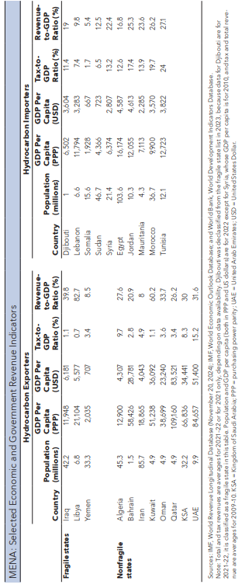
A region with differences—size and economic structure
Notes:
Tax revenue (in % of GDP) declined significantly as a result of COVID-19, regionally and by income group, with some exceptions:
In Europe, the decline has been minor relative to other regions
The decline in LICs and EMEs was more important than in

Slide 5

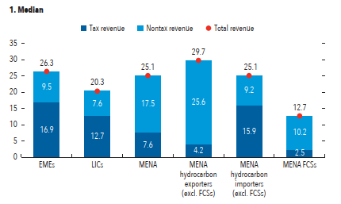
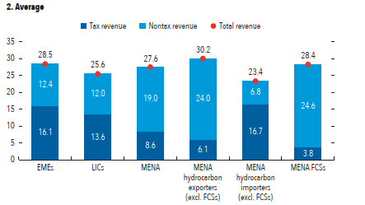
The relative importance of non-tax revenues imply higher sensitivity to shocks

Slide 6

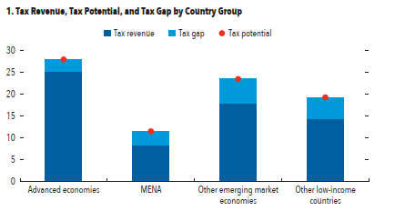
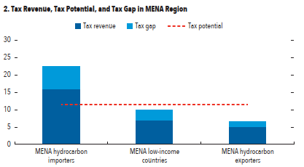
Tax potential: how much taxes can MENA countries raise

Slide 7
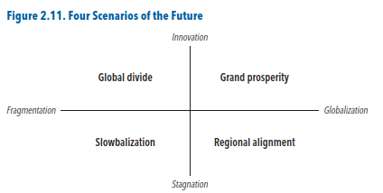
Where do we go from here?

Slide 8
The state and potential of income taxes
Personal income and wealth taxes
Corporate income taxes

Slide 9
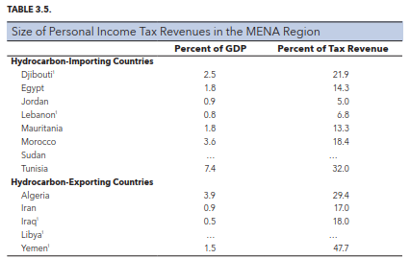
PIT plays a very small revenue role across the region—except in Algeria, Morocco, and Tunisia
In most countries, less than 2% of GDP
Changes in revenue over time driven primarily by economic factors—not policy factors—per-capita income and public sector wages

Slide 10
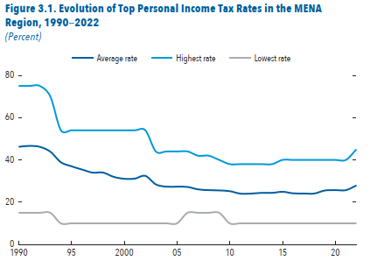
PIT rates have declined substantially over the years
Three evolutions
  Top rates declined the most, and stabilized from 2010
  Low positive rates increased slightly since 2000, by about 1 point
  Exempt threshold declined from 1.5 to 0.4 of per capita GDP
Overall impact is a compression of the rate schedule—hence less effective progressivity
Little taxation of capital income

Slide 11
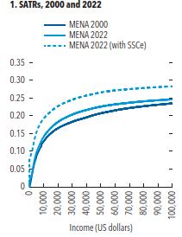
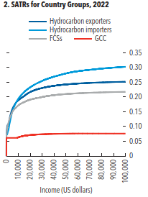
Steep progressivity at relatively low-income levels
Statutory progressivity is characterized by rapid increases in rates at relatively low- income levels
Social security contributions magnify this effect—especially because they are flat
On average, little change in the shape of the statutory progressivity since 2000—Morocco stands out

Slide 12
PIT reform options
Hydrocarbon-exporting countries without a PIT
Mimic a PIT with VAT + SSCs
Basic PIT: high exempt threshold with low rate—like Oman has proposed—and light taxation of capital income—like UAE did
Hydrocarbon-exporting countries with a PIT
Modernize as political economy and administrative capacity become more conducive
Fragile states: a simple final withholding system
Hydrocarbon-importing countries
Reconsider the gap of labor and capital income taxation

Slide 13
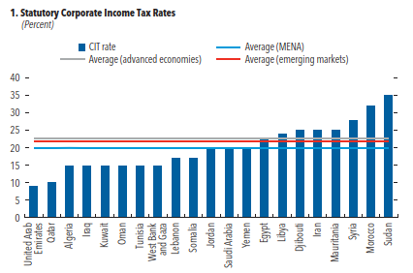
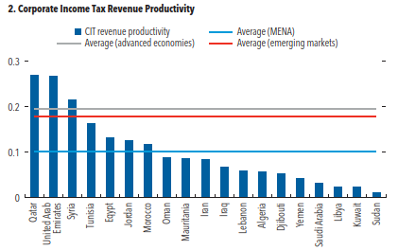
Corporate income taxes: rates and revenue productivity

Slide 14
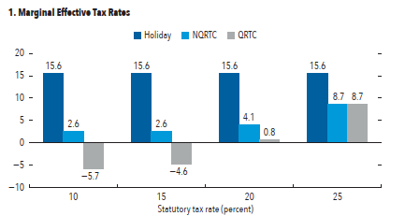
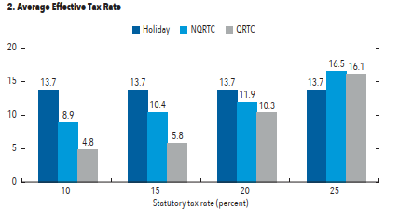
CIT incentives and global minimum tax

Slide 15
Policy options
Rates can be set slightly higher
The landscape of tax incentives is one of fragmentation
Minimum domestic taxes can be useful backstop to ineffective incentives—since revenue is likely to accrue to residence jurisdictions of multinationals
More effective taxation of capital gains—including from offshore indirect transfers
Domestic excess profit taxes can be efficient complements to the CIT—this is for instance the original intent of Pillar I, but for limited number of multinationals

Slide 16
The opportunity of more efficient property taxes

Slide 17
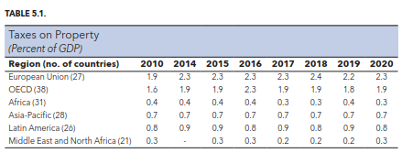
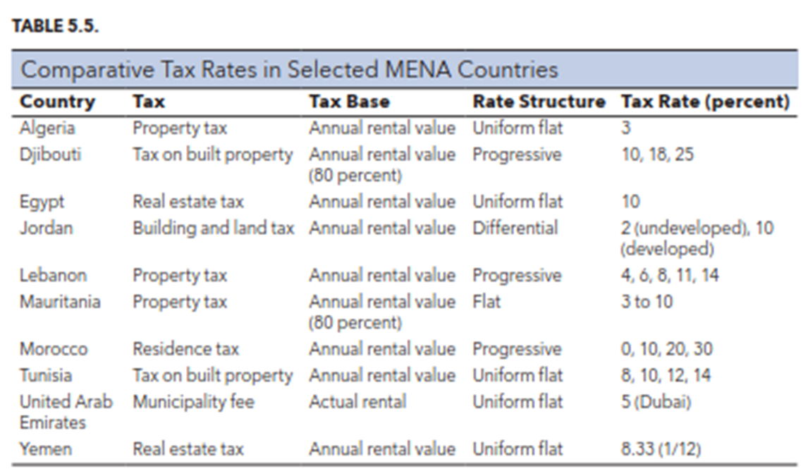
The state of property taxes
Recurrent and transfer taxes generate little revenues—despite high rates
This is due to policy design issues (such as exemption thresholds and exempt properties) as well as to governance issues
Rental value is the main valuation method, with rates varying significantly
Transfer tax rates are often very high

Slide 18
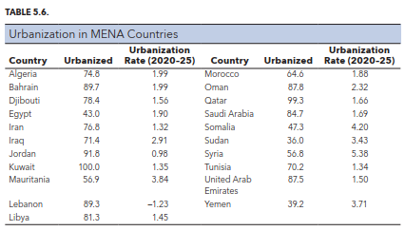
Urbanization will continue to exert pressure on public services—hence need for additional revenues

Slide 19
Policy options
Bring in vacant land and unoccupied buildings; improve valuation systems
Reconsider the use of transfer taxes
Introduce capital gains taxation in the personal income tax

Slide 20
Consumption taxes
Value-added taxes
Excise taxes

Slide 21
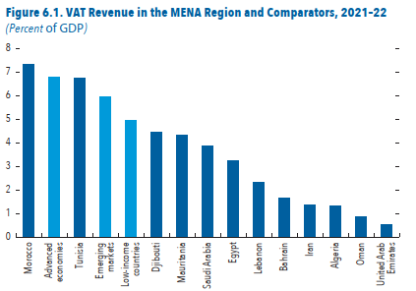
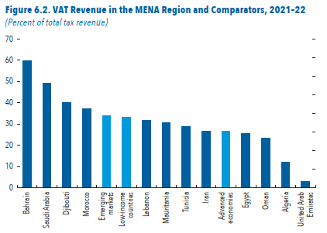
Value-added taxes are now common in most countries, and yield substantial revenue…

Slide 22
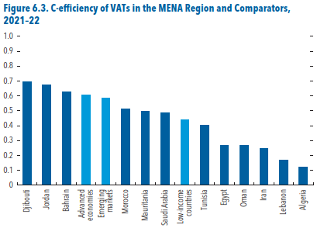
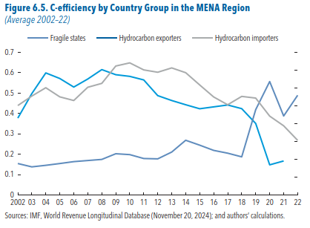
…but their revenue efficiency is declining

Slide 23
Policy options
Improving buoyancy of VATs implies that they must move with economic activities and diversification
Multiple rates and exemptions, and low and multiple registration thresholds, are complex administratively—especially in low-capacity countries
Piece-meal approaches for a broad-base tax such as VAT are unlikely to work—and may create more fragmentation in compliance and unintended consequences
Deeper analysis and monitoring of the revenue and distributional consequences are necessary to gather evidence for fundamental policy reforms
In fragile states without a VAT—simple turnover taxes with limited exemptions to ensure production neutrality are best as long as fragility persists

Slide 24
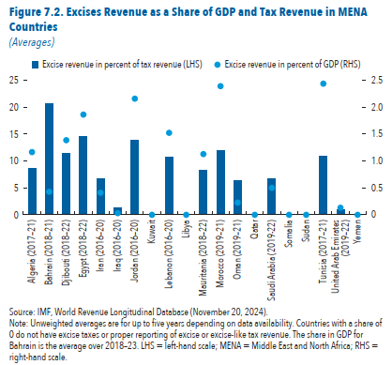
General excise taxes
Most countries do not have a stand-alone excise tax regime
  Some include them in other laws
Revenue decline by half since 2000—from 2% to 1% of GDP
Decline over time caused by low specific rates—gasoline and cigarettes
Policy options:
  Structured legal approach
  Simplicity and a focus on externalities and internalities

Slide 25
Climate and energy transition
Corrective taxes on fossil fuels
Oil and gas taxation

Slide 26
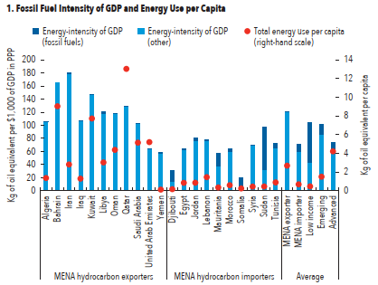
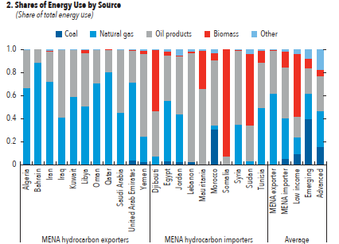
The potential of corrective taxes on fossil fuels and energy

Slide 27
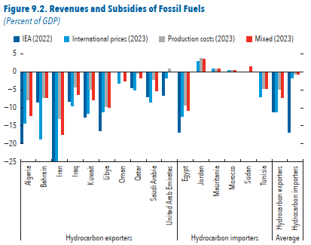
Retail vs. pre-tax prices suggests substantial subsidies to fossil fuels
Despite some progress in bringing fossil fuel prices to market levels, subsidies persist
Subsidies are particularly high in hydrocarbon exporters
Monitoring of explicit and implicit subsidies can help better explain the consequences of mispricing fossil fuels

Slide 28
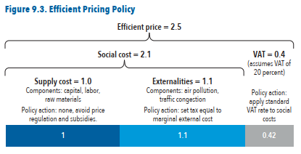
How to price fossil fuel

Slide 29
Possible policy actions
Gradual removal of explicit subsidies—price to international cost
Pricing externalities
  Starte with taxing fuel use—depending on CO2 and climate impact
  Congestion, road damage, and accidents
Sectoral approach: power, industry, transportation, building
Distributional implications, offsetting policies, and revenue neutrality

Slide 30
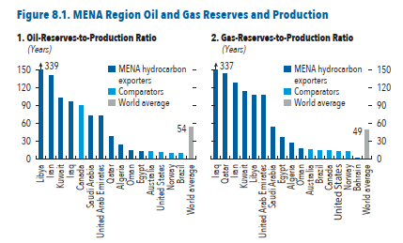
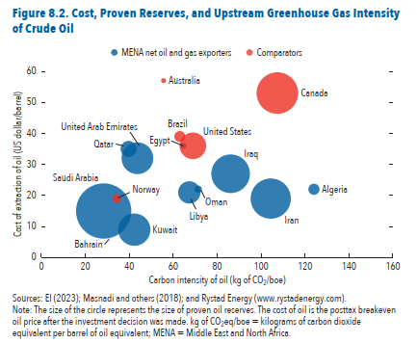
Oil and gas: reserves, production, and competitiveness

Slide 31

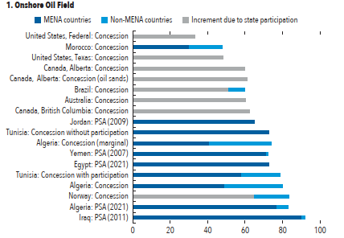
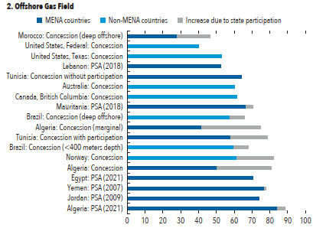
Relatively high average tax rates

Slide 32

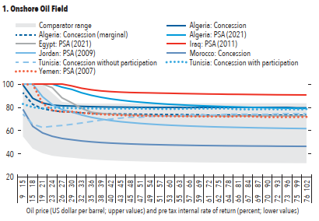
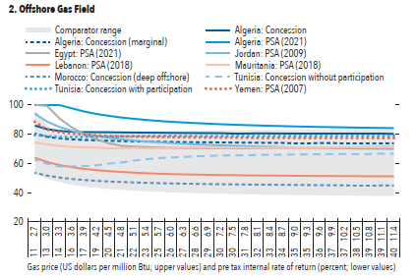
Generally regressive fiscal regimes

Slide 33
Possible policy actions
Level of average tax rates does not seem to be an issue—especially in well-established producers
Composition of fiscal instruments, however, can be made more optimal
More efficient instruments, however, raise capacity issues in tax administration—countries must weight the trade-offs, and invest in administrative capacity

Slide 34
Tax administration

Slide 35
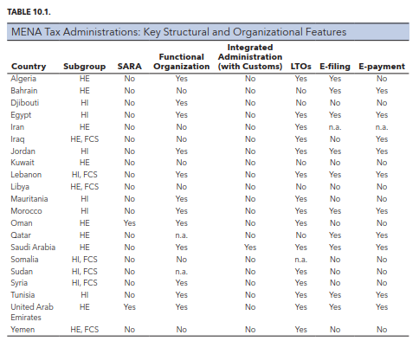
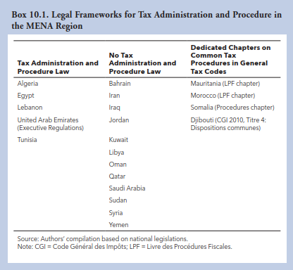
Key functions of tax administrations and legal framework

Slide 36
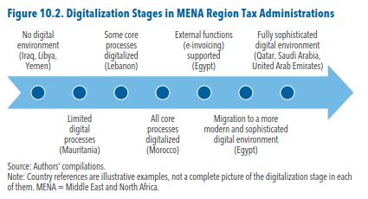
Digitalization stages

Slide 37
Summarizing
Countries can better leverage the role of taxation in development, and build more resilient fiscal systems
For most countries, there are many options to consider given their starting point
All options raise difficulties: some technical; some political
  History and economic structures in particular weigh heavily on political decisions for tax reforms
Looking at developments since 2000, questions is not whether to reform, but how and how quickly—recent war in the region make this more salient
Next 25 years may be more transformative than the past 25

Slide 38
Thank you! mmansour@imf.org

